Slide 1
Ready for Kindergarten Math

Slide 2
Uncover the math in our everyday living!

Slide 3
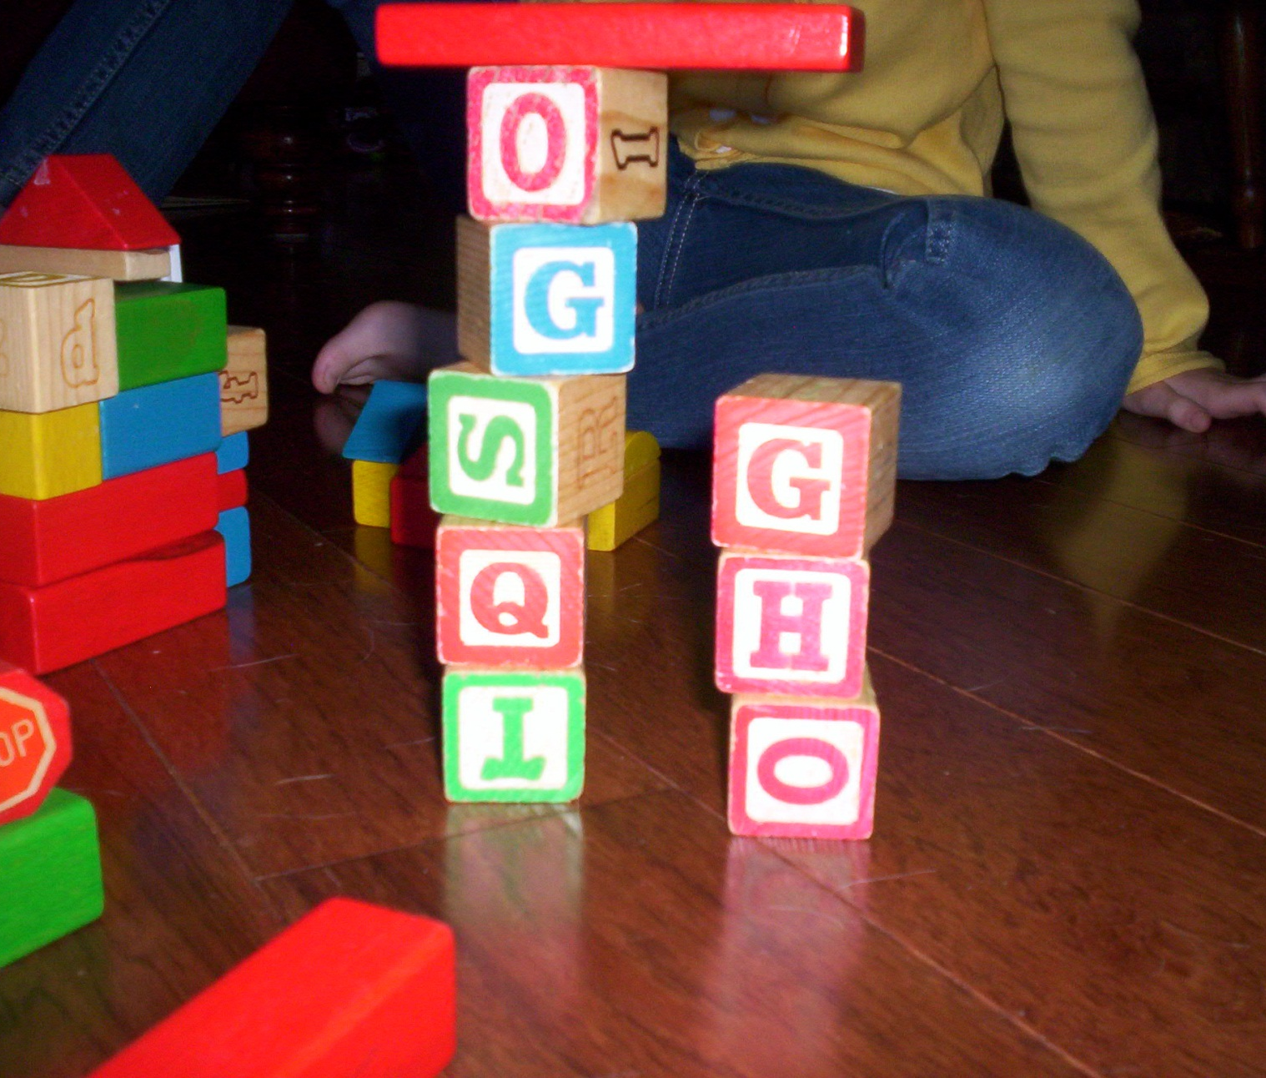
Building with blocks

Slide 4
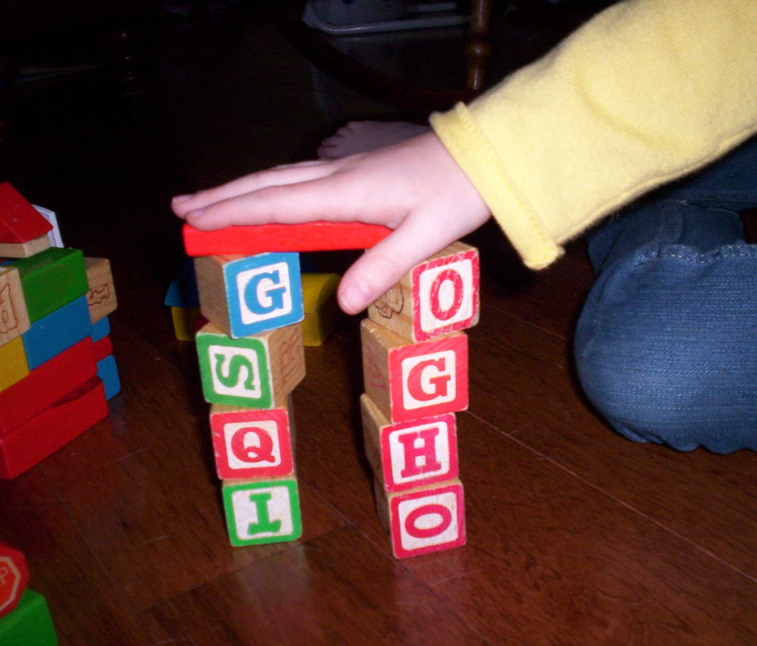

Slide 5
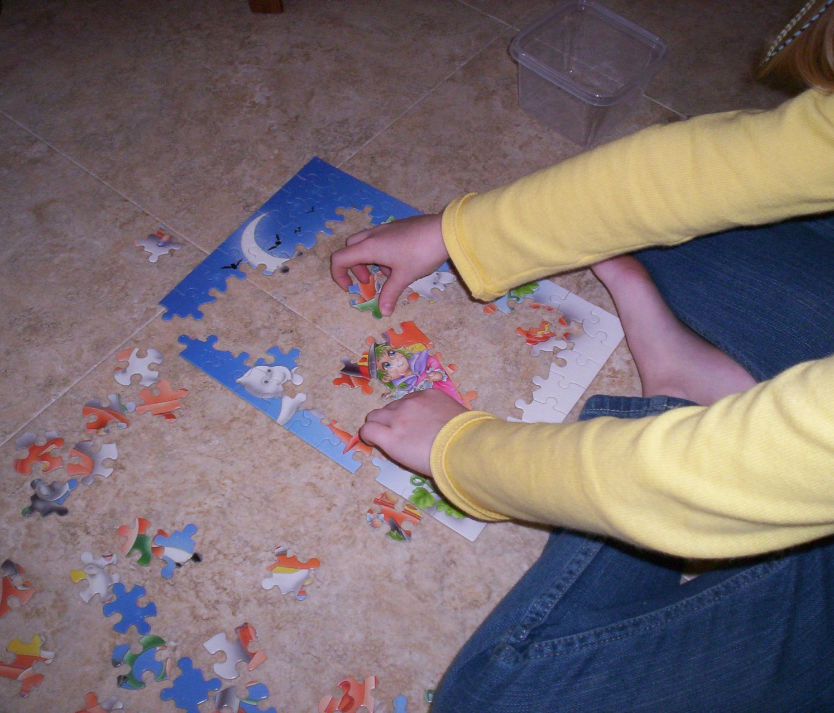
Doing puzzles

Slide 6
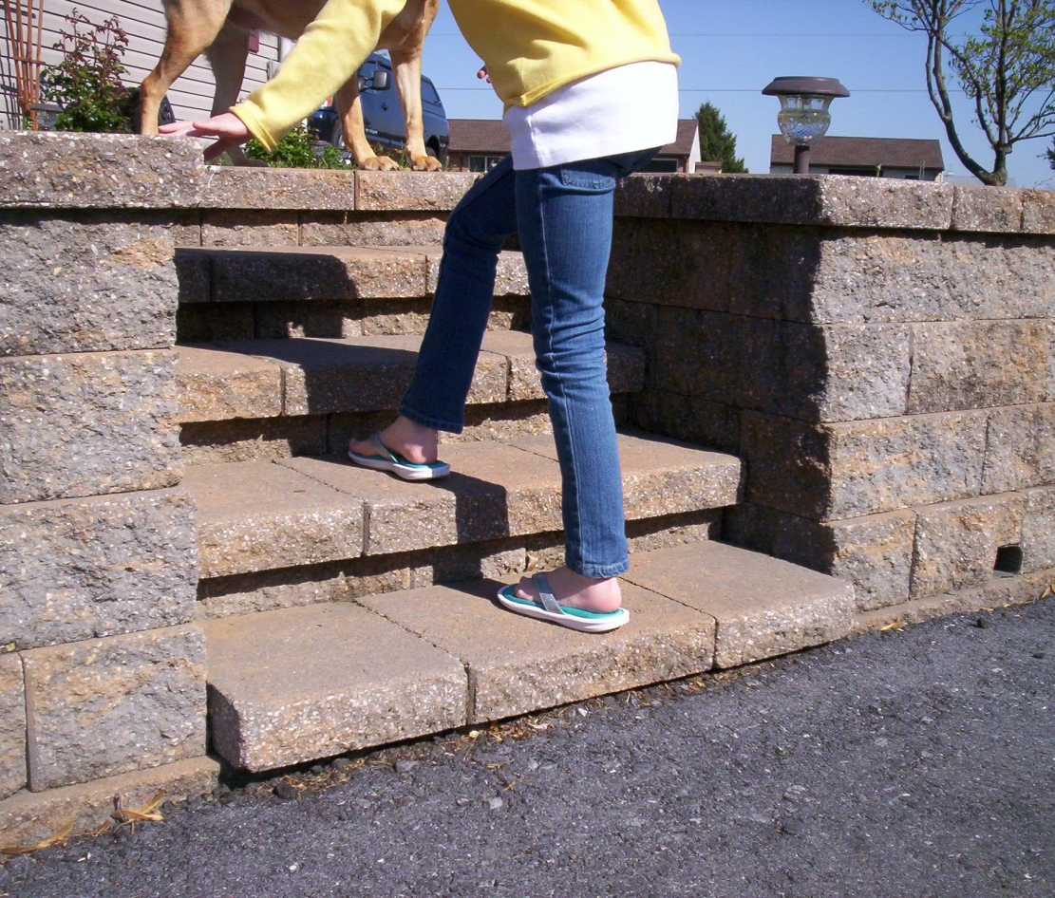
Counting to 20

Slide 7
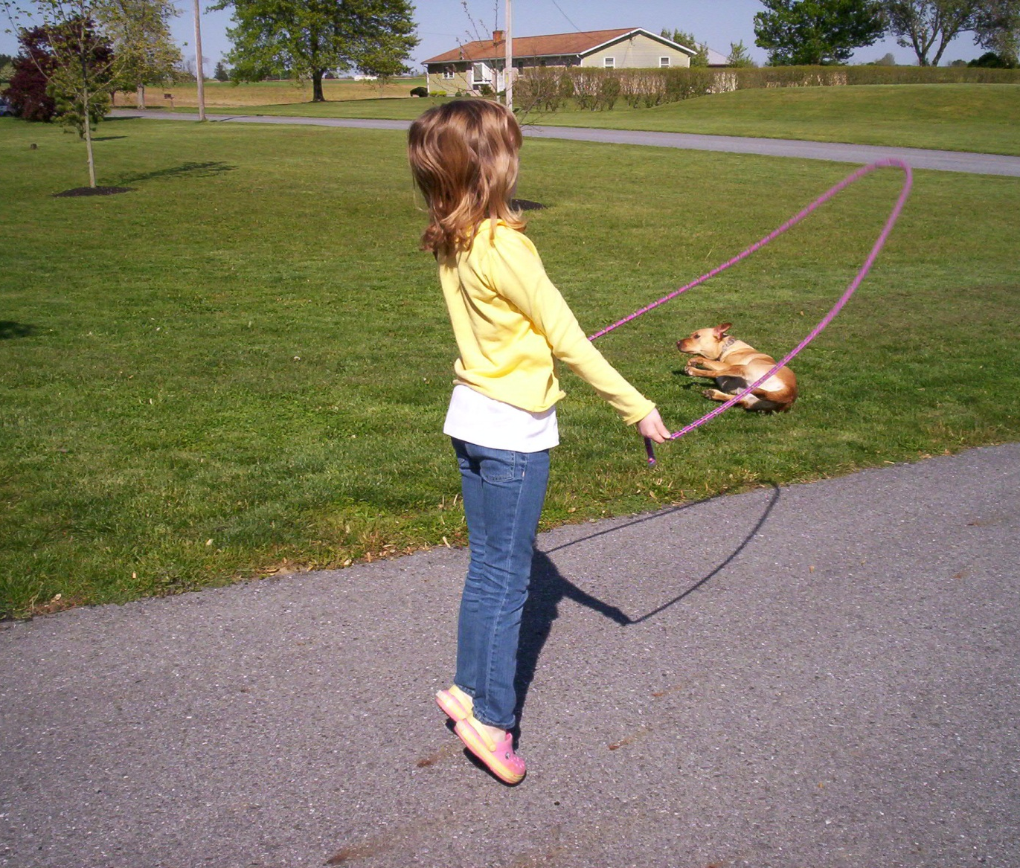
Count everything !

Slide 8
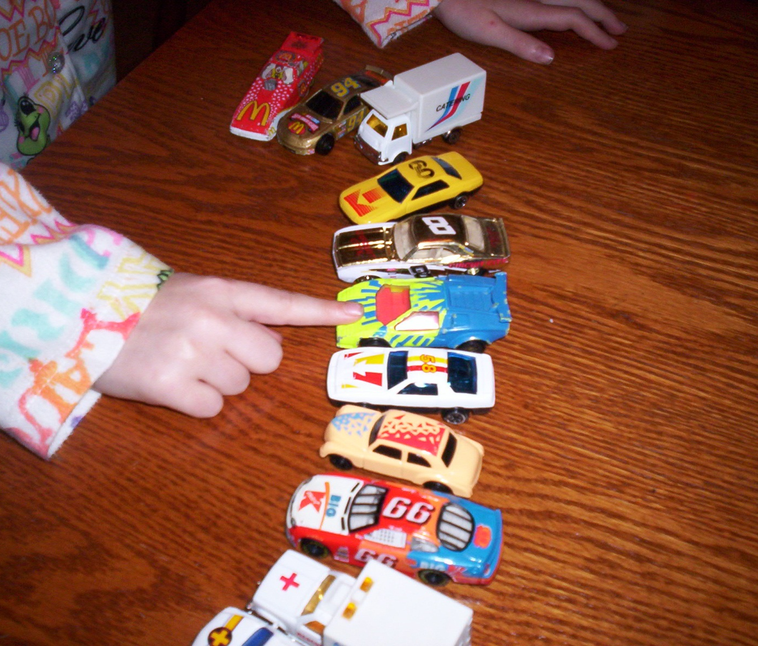
1 item
1 count

Slide 9
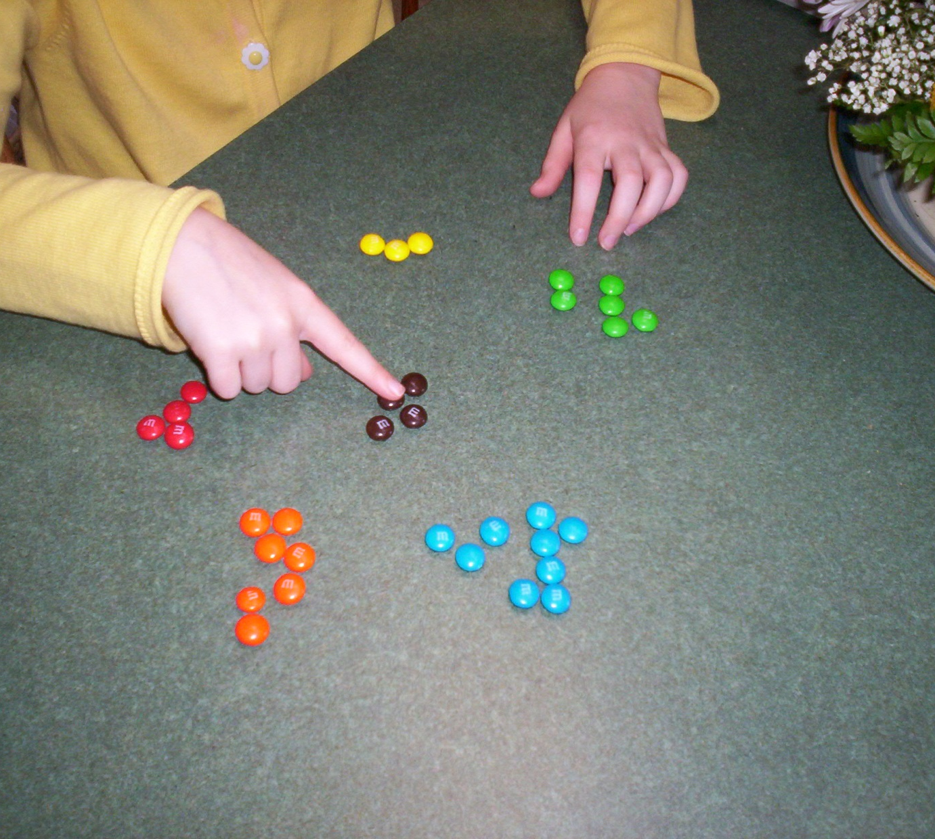
Sorting

Slide 10
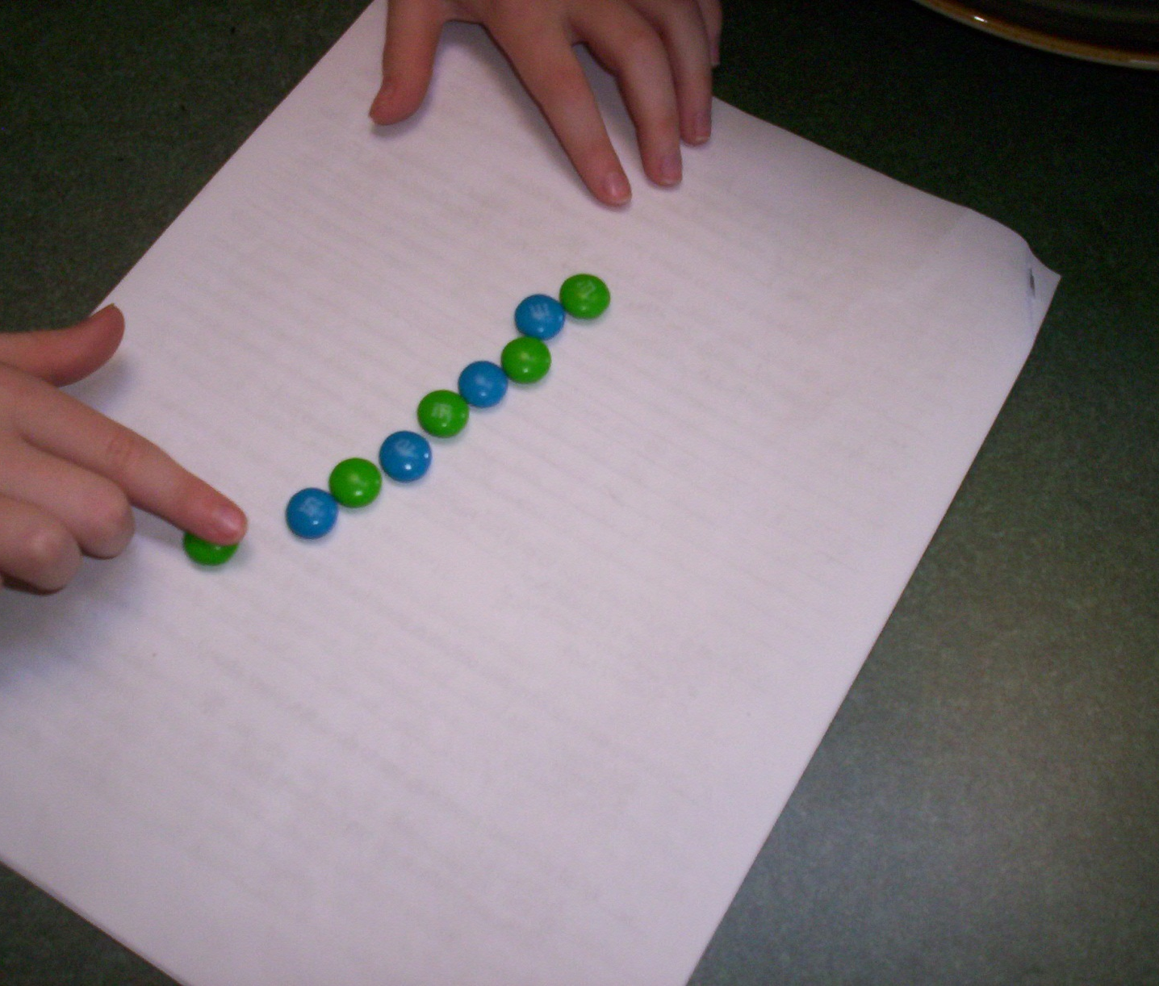
Patterning

Slide 11
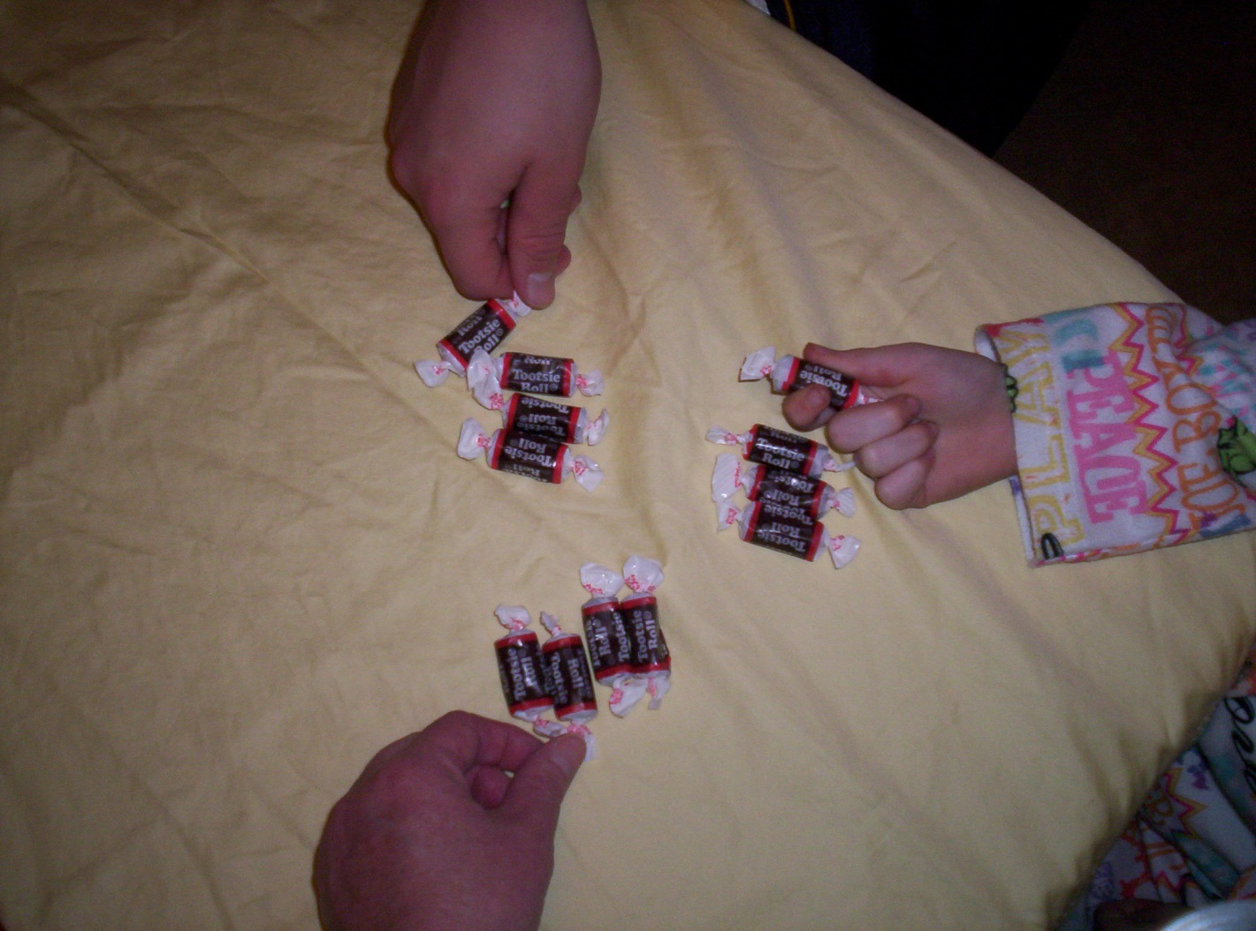
Sharing equally

Slide 12
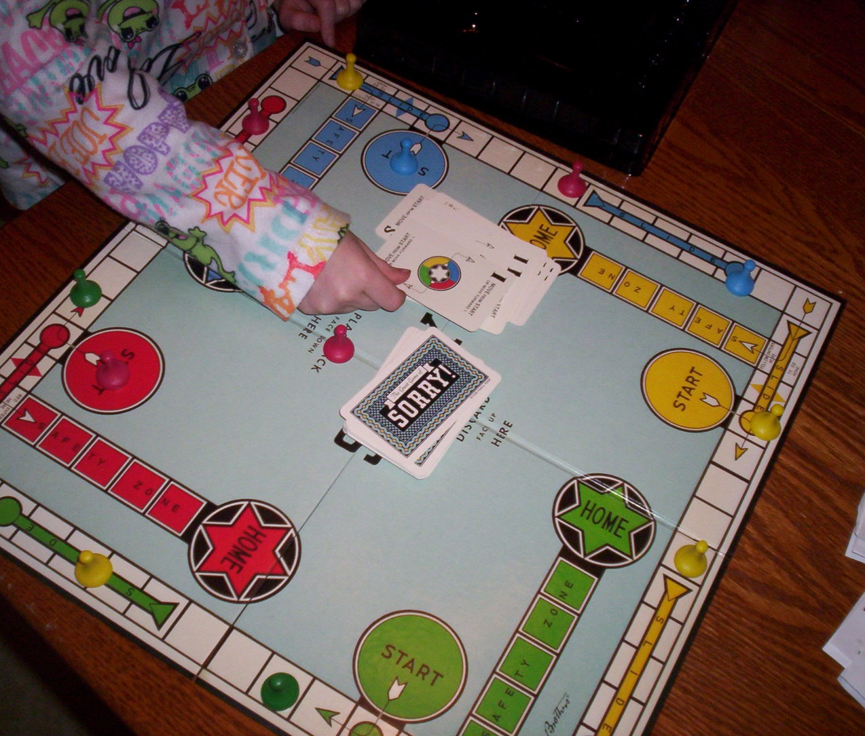
Board games

Slide 13
Numbers that tell about me
Age
Birthdate
Address
Telephone number

Slide 14
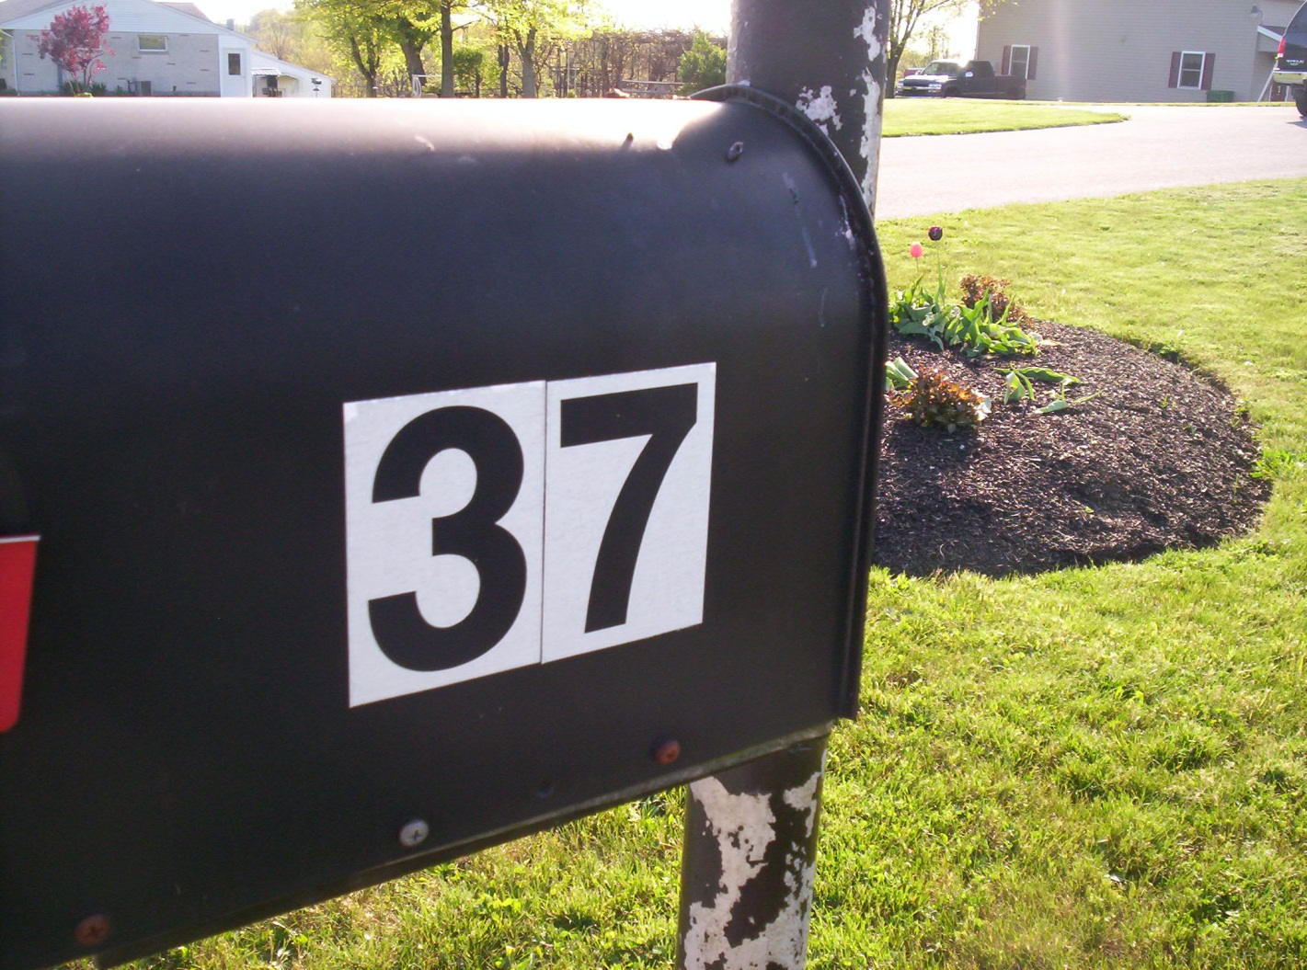
Numbers in our environment

Slide 15
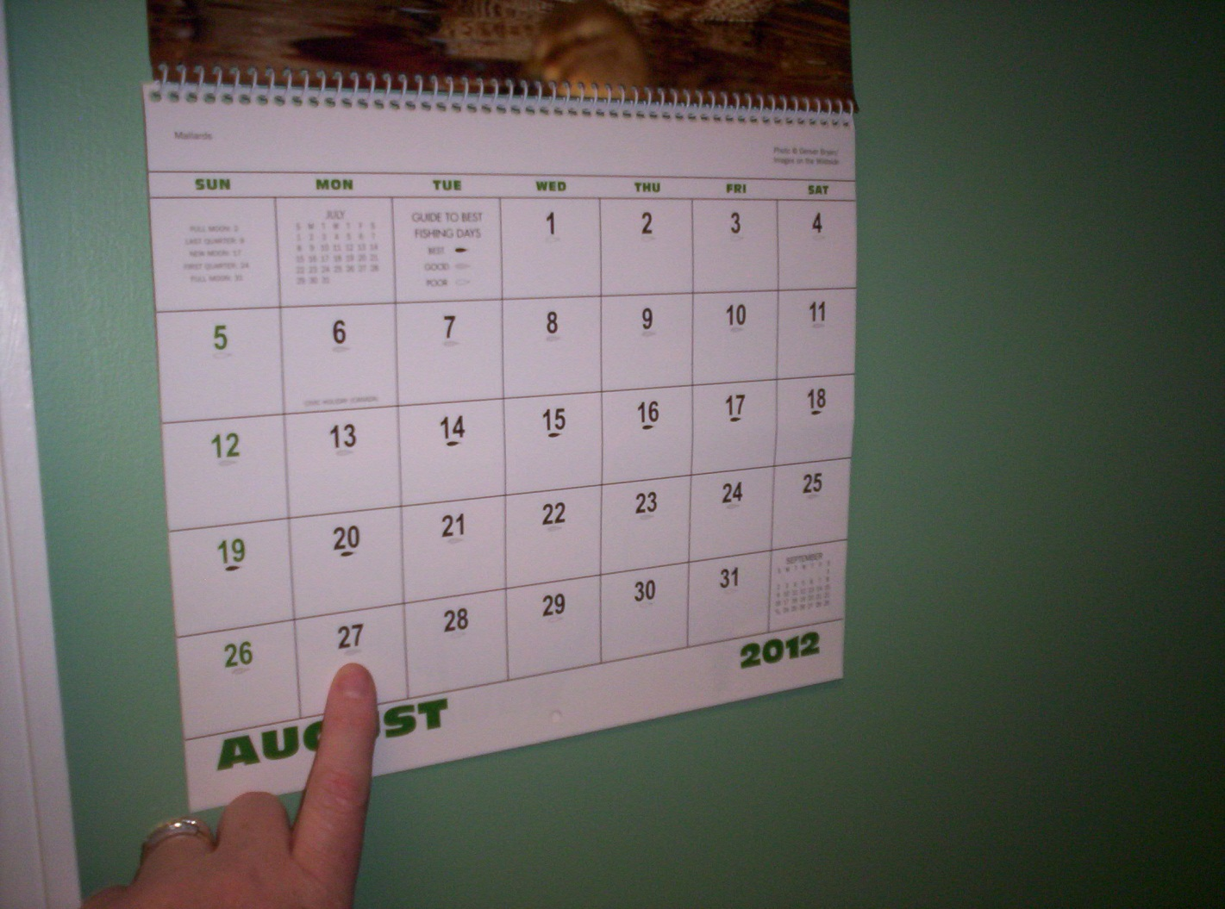
Family calendar

Slide 16
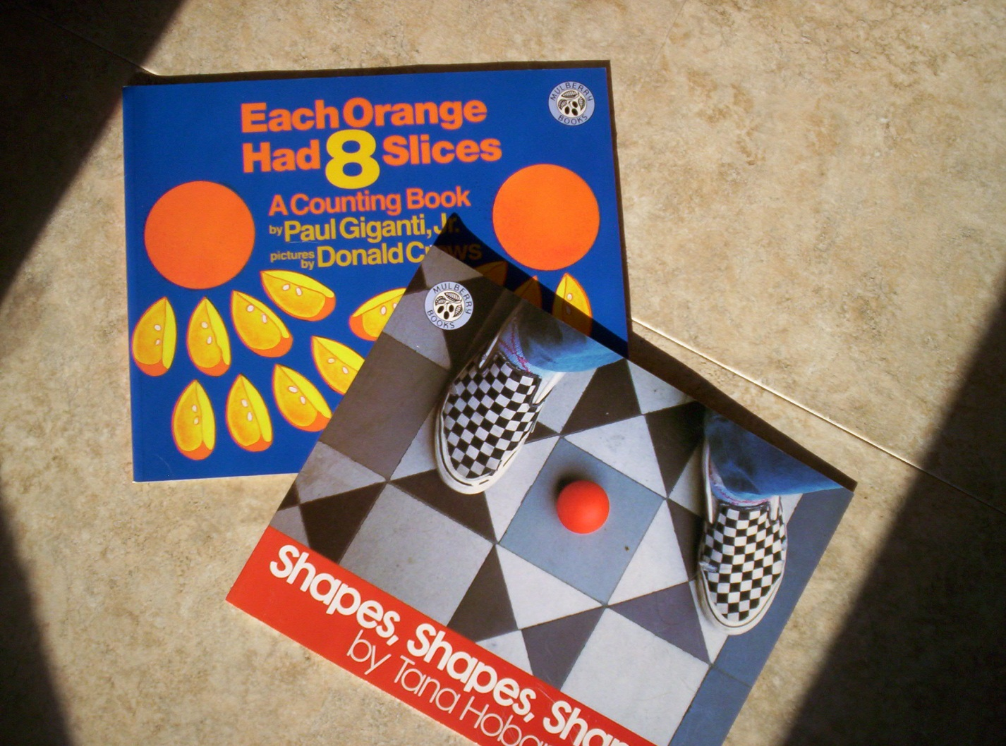
Math literature

